Slide 1

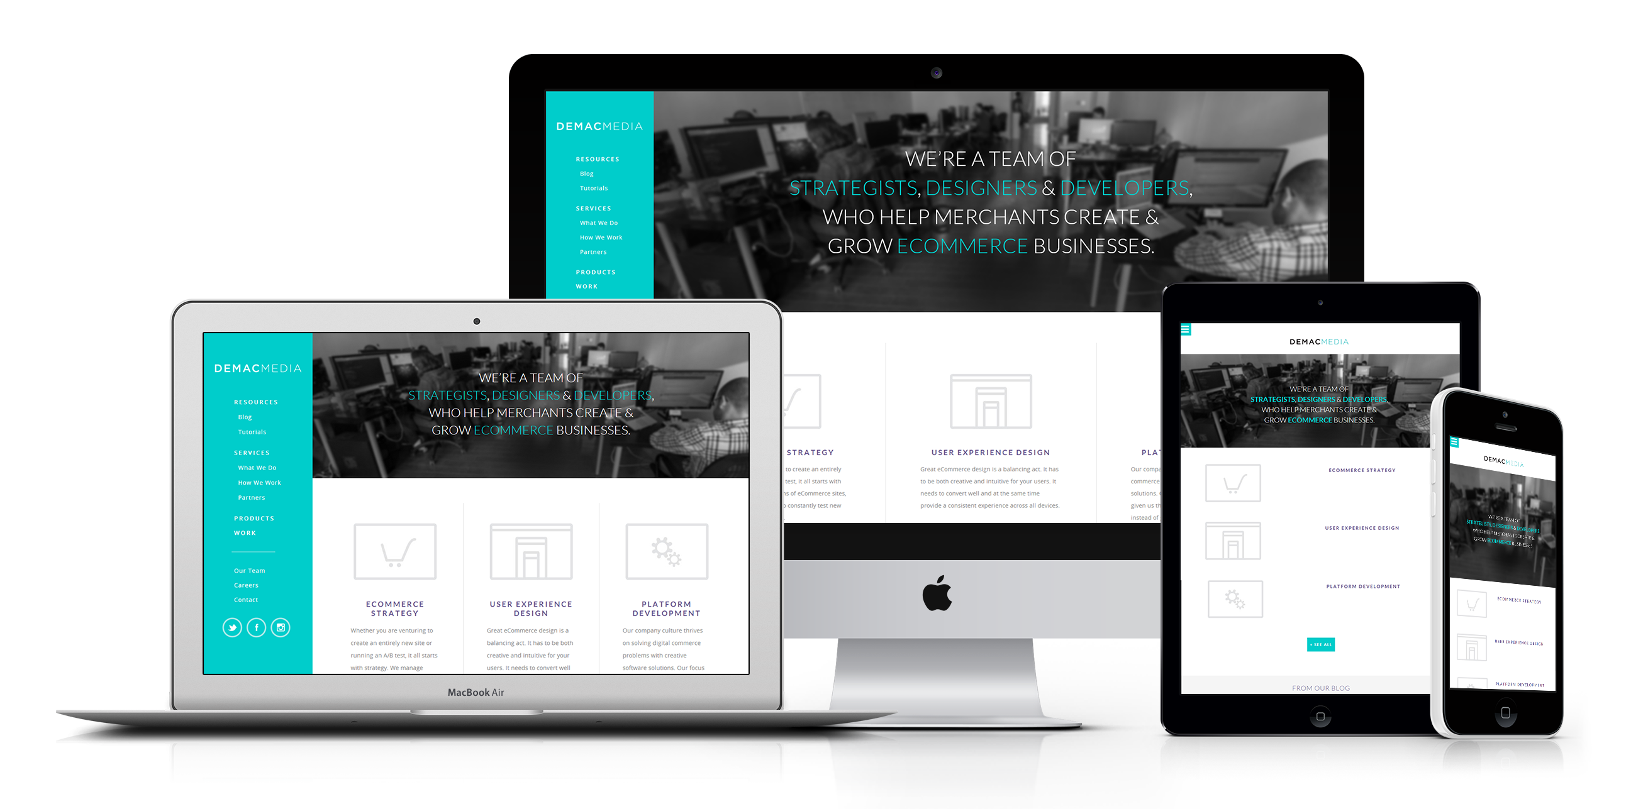
ABES Engineering College Ghaziabad,(U.P.)
Mini Project or Internship Assessment
- KCS-554
Project Domain -
Web Designing
Team Members (Name & Roll.no.) :--
ONLINE CHARITY MANAGEMENT SYSTEM
Branch – Computer Science
Section- B
HIMANSHU SIKARWAR (2000320120085)
KAPIL PANWAR (2000320120093)
KUNAL SRIVASTAVA (2000320120099)
MRADUL PRATAP (2000320120111)

Slide 2
TABLE OF CONTENTS :-
01
03
About the Project
Project Goals
02
04
Major Requirements
Project Stages
What | How its Made | Present & Future
Resource | Positioning | Execution
Data | User Experience
Three Different Phase Done During Internship

Slide 3
WHAT WE ARE WORKING ON :-
SECURE
ACCESSIBLE
FAST AND RELIABLE
Get an SSL Certificate
(SECURE SOCKET LAYER)
Website must be Responsive to all Devices
By Using Compress Data.

Slide 4




ABOUT THE PROJECT
A website that allows Charities to increase operational efficiencies and reduce costs by eliminating much manual paper work. The main objectives of this project is to develop the charity website which helps to raise funds through online transfer, online appointment .

Slide 5
Analysis of Problem Based on Project Objective :-
1-Difficulty Retaining Donors Acquired Online.
2-Choosing the Wrong Fundraising Software/Websites.
3-Ineffective Marketing of Fundraising Opportunities.
4-Setting Demotivating Campaign Goals.
5-Limiting Event-Based Fundraising Oportunities.

Slide 6
PRESENT
POOR DESIGN
PROGRAMMING MISTAKES
LACK OF ADAPTABILITY

Slide 7
FUTURE
BRANDING
POSITIONING
ADAPTABILITY

Slide 8
MAJOR REQUIREMENTS
DATA
USER EXPERIENCE
Data gathered from online Donors who want to donate through websites.
To make a Donation service easy, enjoyable, and accessible to every user.

Slide 9
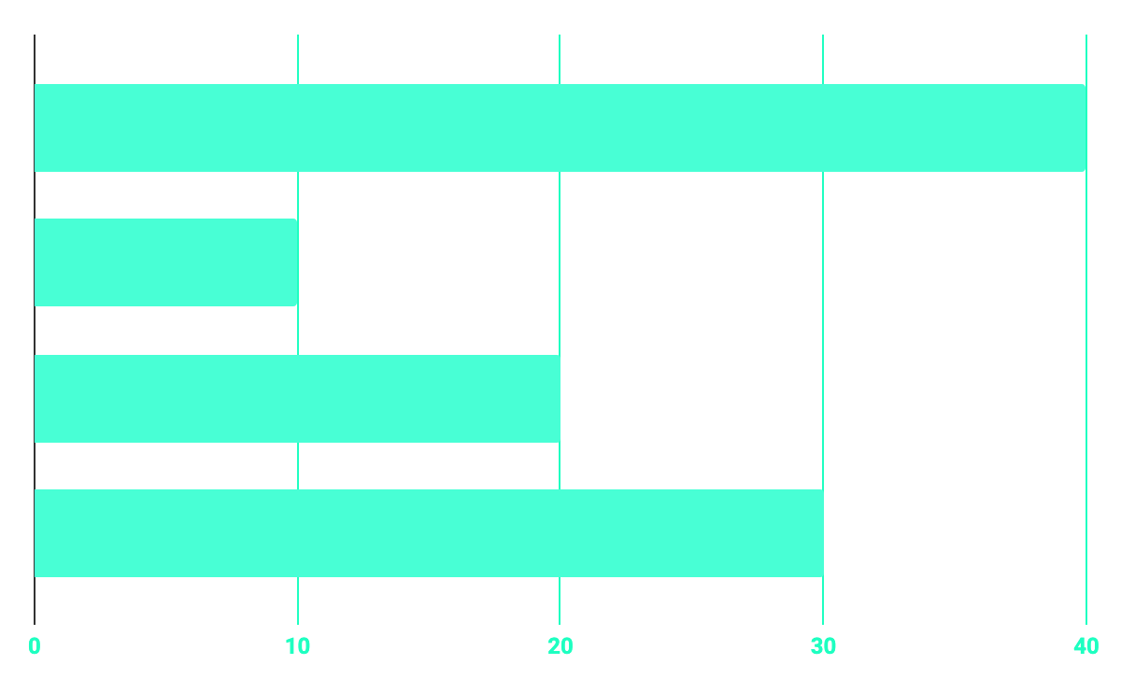
WORK DONE
40%
20%
PROGRAMMING
10%
30%
DATABASE
WEB DESIGN
UX RESEARCH

Slide 10
OUR GOALS
EXECUTION
POSITIONING
RESOURCE COLLECTION
Deployment of project in front of User.
Implementing all the Architecture of Website in the form of Code using Frontend & Backend.
Collecting all the resources regarding Designing & Structure of Website.

Slide 11
PROJECT STAGES
STEP 2
STEP 1
STEP 3
Margin & padding fixing of code. Improving user design. Adding the articles and data.
Connecting two different Phases of Website.
Hosting & Testing the Website

Slide 12
OUR TIMELINE
WEEK 1-2
WEEK 4-5
START
COMPLETE
WEEK 3-4
WEEK 5-7
HTML & CSS
SQL
BOOTSTRAP
PHP

Slide 13
REFERENCES :-
1 - https://www.w3schools.com/
2 – https://www.geeksforgeeks.org/
3 – https://www.youtube.com/
4 – https://www.google.co.in/
5 – https://www.googlescholar.co.in/

Slide 14
THANKS!
Does anyone have any question?
addyouremail@freepik.com

